Slide 1
The Role of Incentives and Communication in Strategic Alliances: An Experimental Investigation
Agarwal, Croson, and Mahoney (2010)
Modified and Presented by Carter Zagorski, Spring 2023

Slide 2
Introduction
What factors facilitate successful alliance outcomes (undermine gap between potential and realized economic value creation in strategic alliances)?
• Economics game lens: economic incentives alignment (Khanna et al., 1998)
• Social psychology lens: organizational design and deliberate efforts to develop a common understanding and trust (Zeng and Chen, 2003)
Literature on strategic alliance: large gap between potential economic value creation and realized economic value creation in strategic alliances.
The inherent tension between cooperation and competition:
• Invest resources, share knowledge, and build synergies through cooperation, OR
• Pursue private benefit at the expense of the total value creation (“free-riding,” or learning races).
→Remaining questions: the importance of two mechanisms, the contingent factors, the relationships between the two underlying mechanisms.
This paper employs experimental methodology to examine the interplay of the two mechanisms.
• Control endogenous selection effect
• Build a clear causal relationship

Slide 3
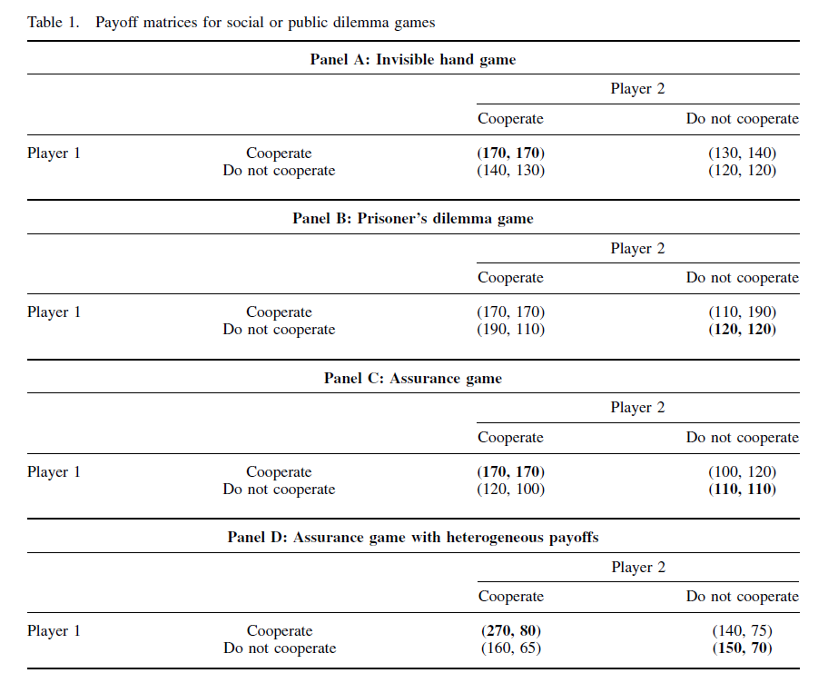
Theoretical Framework
Strategic alliances typically create economic value that have a “common pool” component, and this lack of well-defined property rights invites potential opportunistic behavior and free-riding.
→ Social dilemma: exchange partners must decide on whether to pursue a higher individual payoff through competitive choices, even though the collective payoff is larger with cooperation.
Payoff dominant strategy
Risk dominant strategy
At what condition, partners will choose the pay-off/ risk dominant strategy?

Slide 4
Theoretical Framework
Economic incentives
Property rights theory (with agency theory and transaction cost theory)
Why organizational form matters? It is necessary for the economic incentives to be right to attain efficient outcomes.
Common benefits vs Private benefits → Give or take?
Common benefits are realized by collective ‘giving’ or sharing of information and application of the learning in areas related to the alliance.
Private benefits occur when exchange partners ‘take’ from others in the form of unilateral learning of skills and knowledge and application in areas unrelated to the alliance’s activities.
The extent to which the decision makers perceive common benefits to be greater than private benefits matters.
Hypothesis 1: Alliances wherein decision makers have a higher ratio of common to private benefits are more likely to achieve success than alliances wherein decision makers have a lower ratio of common to private benefits.
The heterogeneity in partner scope and resultant differences in economic incentives. When heterogeneity increases:
(a) the need for coordination is greater when exchange partners must determine the optimal allocation of effort, given differences in relative common benefits from the alliance activities.
(b) the perception of opportunistic behavior by exchange partners increase, even when none may be present. (the potential for misunderstanding & divergent expectations)
Hypothesis 2: Alliances in which there is heterogeneity in strategic alliance partners’ ratio of common to private benefits will have a lower likelihood of success than alliances where exchange partners are relatively homogenous in their ratio of common to private benefits.

Slide 5
Theoretical Framework
Communication
Even in strategic alliances wherein decision makers perceive a higher ratio of common to private benefits ratio, lack of coordination due to insufficient common knowledge, differential perceptions of other decision makers’ actions, and the bounded rationality of the participants can result in a gap between potential and realized value creation from a strategic alliance as well.
Classic organization theory or social psychology lenses: structural solutions → motivational/design solutions
Communication helps change partners’ perceptions of the problem from competitive to cooperative.
A flow of information: When decision makers are aware of each other’s incentives and orientation toward the strategic alliance, there is an alleviation of fears related to potential exchange partner misconduct.
Communication reduces coordination costs and addresses management issues related to bounded rationality and decision biases.
Moral suasion, the development of group identity, and trust
Communication permits the development of social capital and trust among strategic alliance partners
Hypothesis 3: The effect of incentive alignment on the probability of success in alliances is higher in the presence of communication than in its absence.

Slide 6
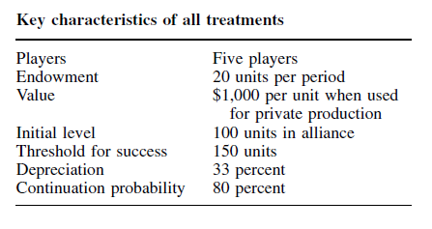
Methodology
Experimental design
Participants: 405 participants who participated as decision makers in strategic alliances. (60 executive MBA students, 300 MBA students, 45 senior-level undergraduates)
Five treatment groups:
1) low common benefit: a scenario where the ratio of
common to private benefits is low
2) high common benefit: a scenario where all of the decision makers have a high common to private benefit ratio,
3) mixed common benefit allows for heterogeneity in the ratio of common to private benefit among the alliance partners.
4) high common benefit with communication
5) mixed common benefit with communication
Comparisons between the different treatments permit an assessment of the individual and interaction effects of economic incentives and communication on strategic alliance outcomes.
Implementations:
The differences in the ratio of common to private benefits are implemented by differences in bonus structure across the alliance simulations.
“Communication” is implemented via a free-form chat box, similar to an instant messaging system, that records all prior messages for others to view and allows for private one-on-one messages.

Slide 7
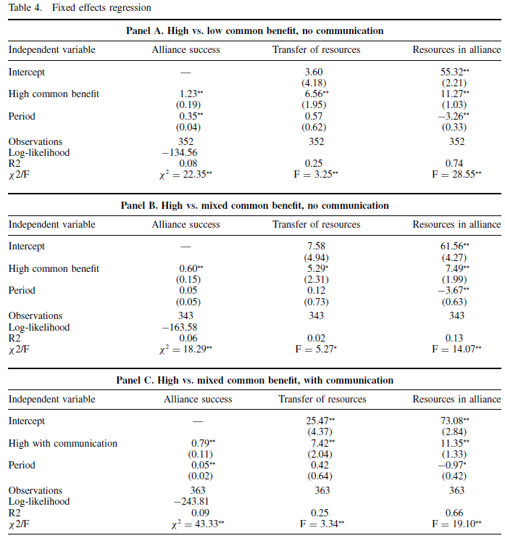
Results
H1 is corroborated
H2 is corroborated:
Regardless of whether there is communication or not, the homogeneous high common benefit treatment has significantly higher performance than the heterogeneous mixed common benefit treatment.

Slide 8
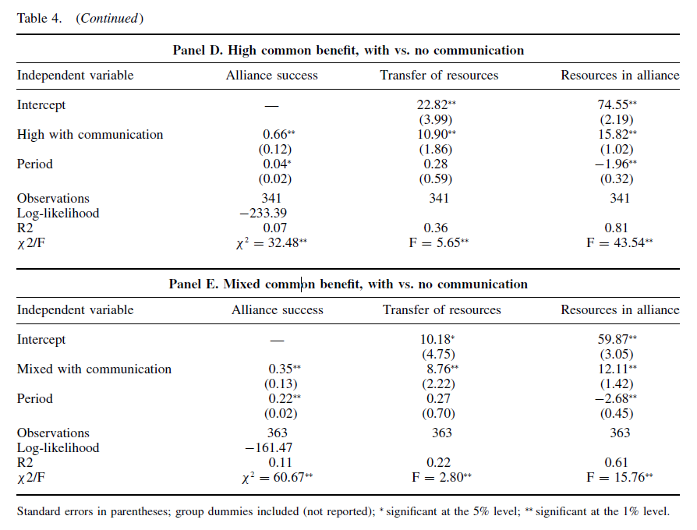
Results
H3 is corroborated
When economic incentives are in place, adding communication in the high common benefit treatment and in the mixed common benefit treatment significantly increase the success rate.

Slide 9
Conclusion and Questions
Economic incentives and interpersonal (communication) processes to overcome bounded rationality are both important to decision making in strategic alliances.
Questions:
This paper justifies its usage of the experiment to mimic strategic alliance partners’ decisions in several ways (the indifference between EMBA and students in the experiment, the work experience of EMBA, and so on). Thus, to what extent can individual-level or group-level decisions represent organizational-level decisions? Is there any category of firm decisions that is more suitable for this method?
Strategic alliances are inherently fragile; threats among alliance members can prevent “deviant behavior” to preserve an alliance. How might future research be designed to examine the dynamics, effectiveness, and takeaways for future situations in which alliance members can/do threaten each other?

